Slide 1


Question bank for Vocational Courses
Submitted By :- Mayuri Raj (Roll no :-630526)
Ayushi Kumari (Roll no :-630543 ),
Ayushi Kumari (Roll no :- 630582)
Under the guidance of :- Ms. Sabitri Sharma

Slide 2
PROBLEM ANALYSIS
No existing system of Question bank for Vocational courses.
Lots of site on google that contains previous year question papers of different Universities.
Very much time taking.
New CBCS system in Patna University.

Slide 3
HARDWARE & SOFTWARE
Hardware :-
CPU :- i3 / Dual Core
RAM :- 8 GB
HDD :-1 TB
SSD :- 256 GB
Mouse :-Optical
Monitor :-LED.
Software :-
Server :- WAMPSERVER.
Language :- PHP, HTML, CSS.
DataBase :- MySQL.
Others :- Microsoft Word, Notepad++, Visual Studio.

Slide 4
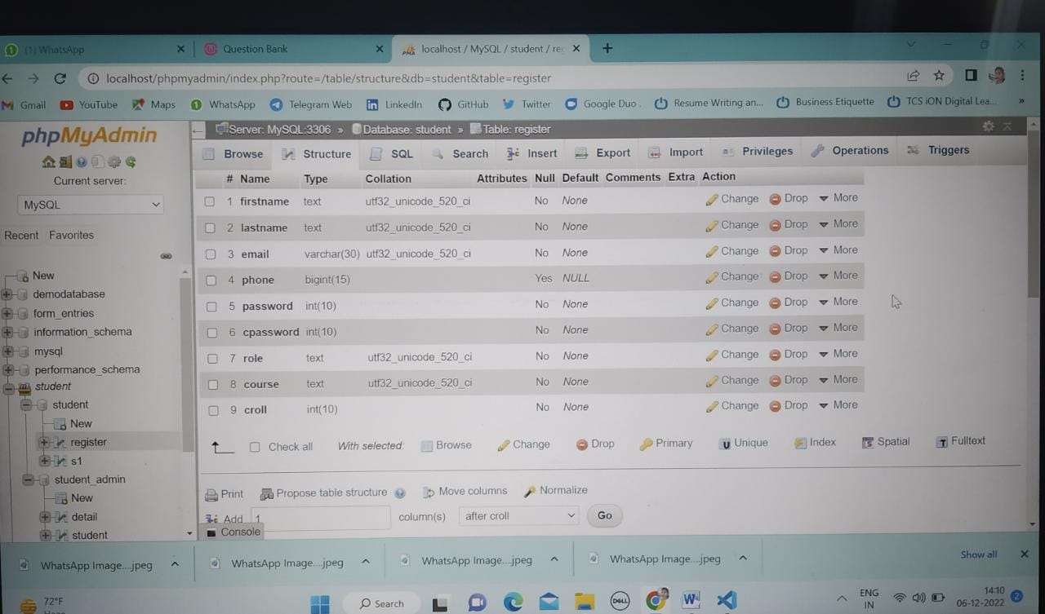
BackEnd
There is a Database named as “ register “ that store the information about the students who signup in the question bank system.

Slide 5
ER Diagram
Name
Search
croll
Student
Question paper
Email
phone
Session
Course
Subject list
Question
pdf
Semester

Slide 6
ER Diagram
Update/
Insert by
Question Paper
Developer
Name
Subject list
Question
Pdf
Address
Phone
Email

Slide 7
FrontEnd Context Analysis Diagram
student details insert/update student
details
Question paper Insert/Update question papers
Student
Admin
Question bank

Slide 8
Data Flow Diagram
Confirmation
User name & password login details Register
Access to home page
Authentication Confirmation
Details student details
Login
Student
Sign Up

Slide 9
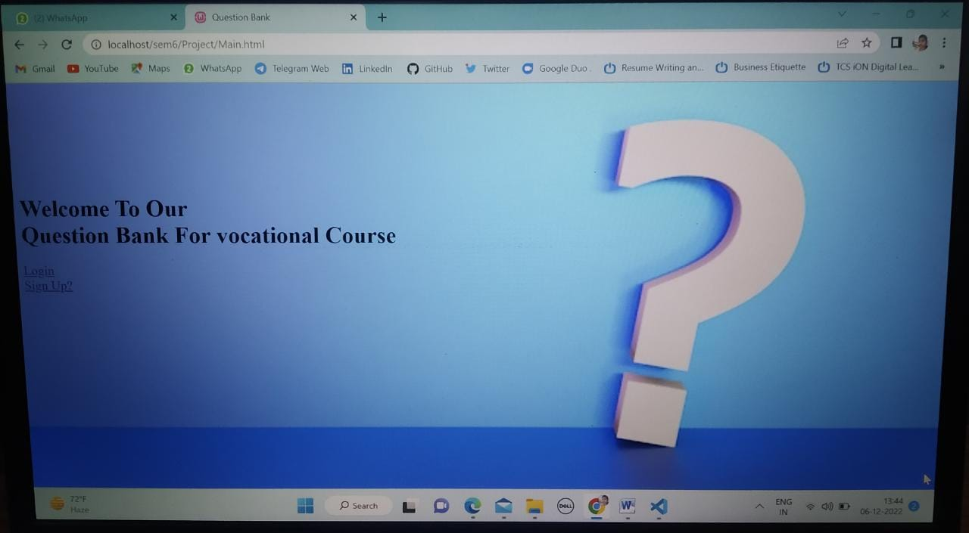
MAIN PAGE

Slide 10
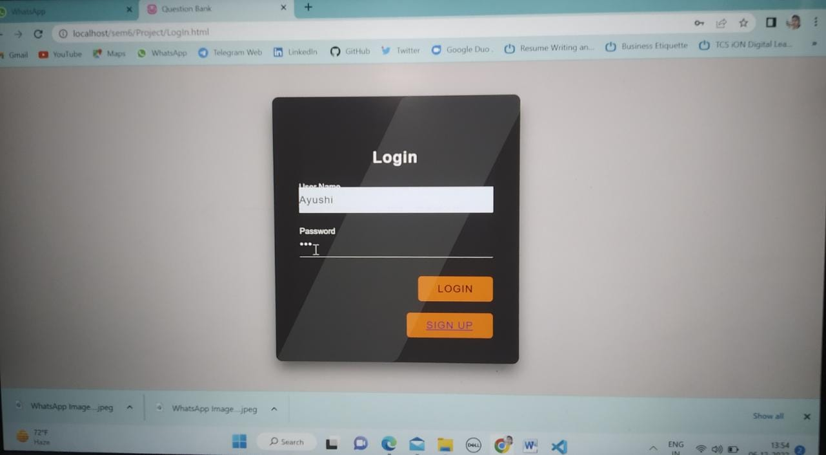
Login Page

Slide 11
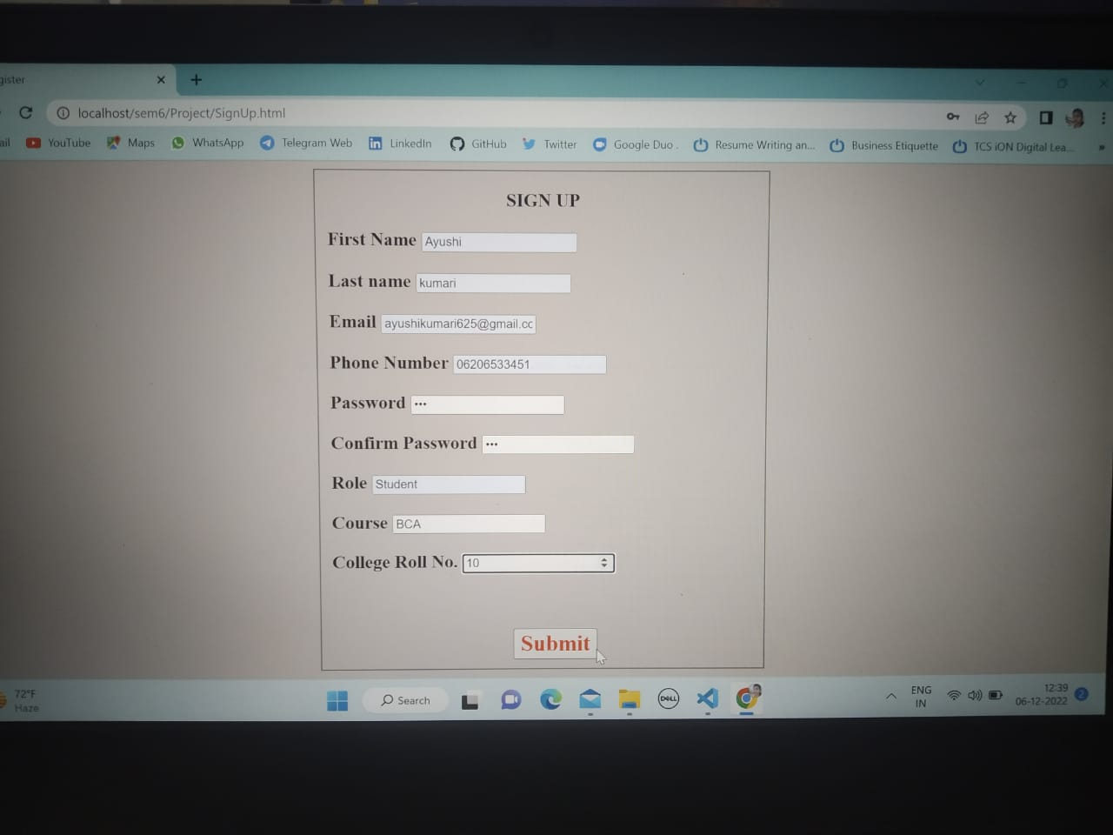
Sign Up Page

Slide 12
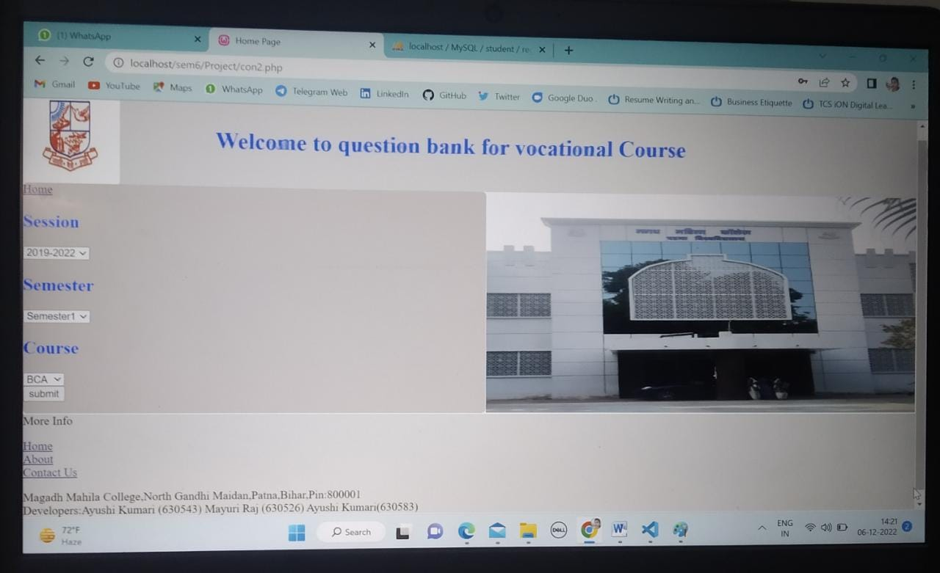
Home Page

Slide 13
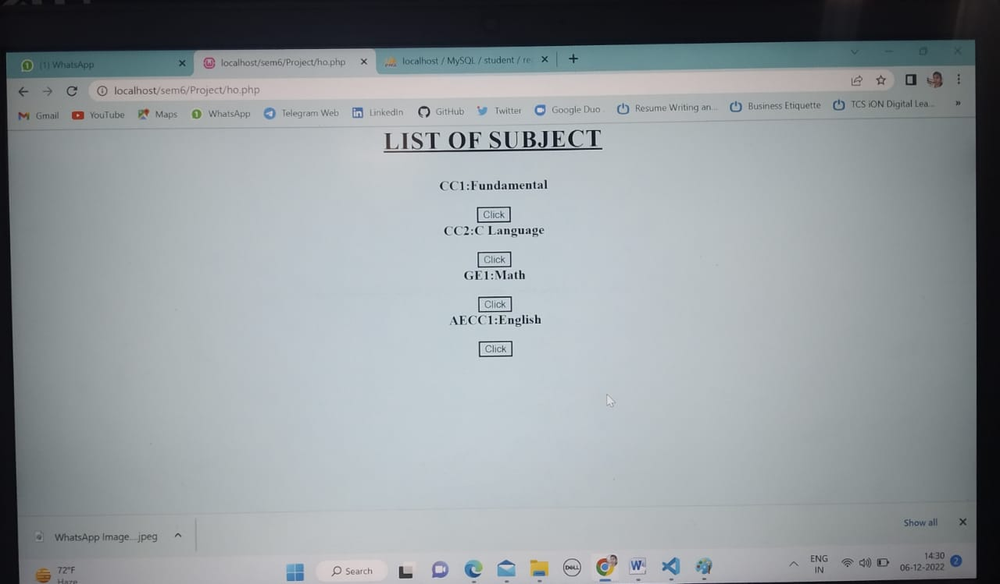
List Of Subjects

Slide 14
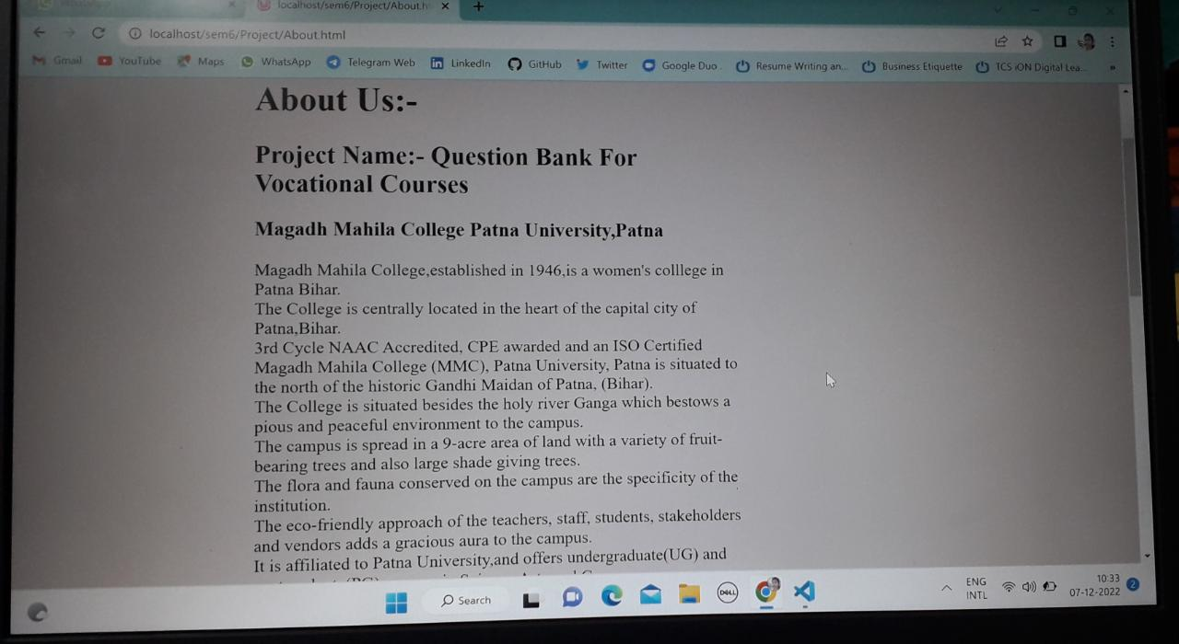
About Us

Slide 15
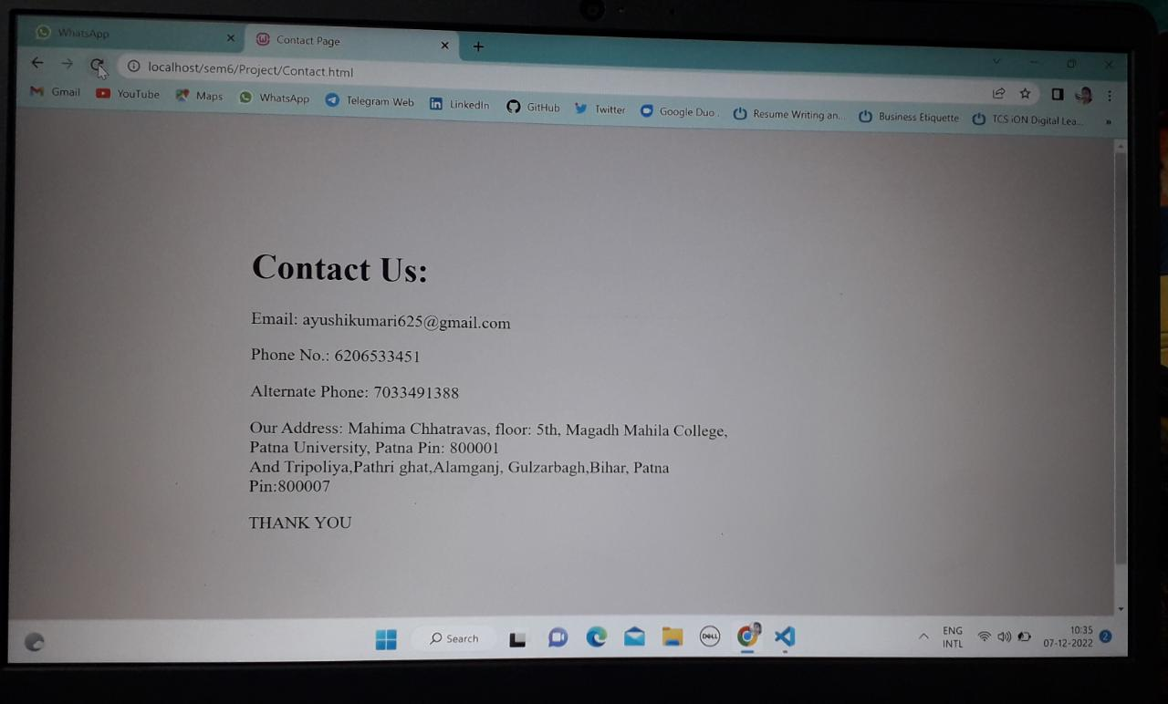
Contact Us Page

Slide 16
Limitation
The new system has been designed to meet almost all the user requirements but it too has certain limitations some of which can be enhanced in future.
Three year Question paper :-The existing system contains only three year question paper from 2019 to 2022. More previous year question paper can be added in future.
Answers not provided :-Questions are not provided with answers. Answer should be added in future.
No time out set for idle screen The existing system allows the user to stay on the particular pages & there is no time out set. Security enforcement will be done with further enhancement in the current applications.
Missing Question Paper :- Some Question papers are missing in this system which can be added in future.
Platform Dependent:- This system runs only on windows operating system.
Static :- Currently this system will run only on our computer.

Slide 17
CONCLUSION
CONCLUSION The Question Bank For Vocational Course is developed using PHP , HTML , CSS and MySQL and this fully meets the objectives of the system which it has been developed. The system has reached a steady state of where all the bugs have been eliminated. The system is operated at a high level of efficiency and the users associated with the system can understand it's advantage. The system solves the problems it was intended to solve as requirement specification. On realizing the importance of systematic documentation all the processes are implemented using a software engineering approach. Working in such an environment enables one to appreciate the intricacies involved in the System Development Life Cycle (SDLC). We have gained a lot of practical knowledge from this project, which we think shall make us in a good stand in a good state of future

Slide 18
References
Website :-
➢ Tutorialspoint.
➢ JavaTPoint.
➢ Campuslife.co.in
➢ W3school.
➢ Etutorial.co.in
➢ Youtube.

Slide 19
THANK YOU

